Slide 1
Fee-for-Service Training
OH Medicaid

Slide 2
What is Ohio Medicaid Fee for Service?
Ohio Medicaid Fee for Service or FFS for short is also referred to as Traditional Medicaid. This is a method in which doctors and other health care providers (such as pharmacies) are paid for each service they provide.

Slide 3
Ohio Medicaid FFS joins SPBM on July 1, 2023
What does this mean to you? There are SIGNIFICANT differences between Managed Care vs FFS pharmacies claims!!!!
This is what we are learning about today!
After this training, please make sure that you are studying this PowerPoint document. An assessment of your knowledge will be given in the very near future!

Slide 4
Ohio Medicaid FFS
The Ohio Medicaid Fee for Service plan is currently being serviced by Change Healthcare. On July 1, 2023, all ODM FFS members will be serviced by Gainwell.
Some members and providers may be confused by this change, and it is our job to assist and limit the amount of confusion!
You will no longer be transferring calls regarding FFS to Change Healthcare

Slide 5
Ohio Medicaid FFS
There are now two different Pharmacy Reference Guides
One for Fee for Service located here:Gainwell OHSPBM FFS Pharmacy Reference Guide v1.0_07.2023.pdf (ohio.gov)
One for Managed care located here: SPBM Pharmacy Reference Guide.pdf (ohio.gov)

Slide 6
BIN/PCN
BIN – Bank Identification Number
PCN- Processor Control Number - It is important to understand that the Managed Care and FFS PCN’s are different!
Fee-for-Service | Managed Care
BIN: 024251 | BIN: 024251
PCN: OHRXPFFS | PCN: OHRXPROD
More plan restrictions | More of a "commercial" third party plan
**IMPORTANT** FFS BIN/PCN are changing from the former CHC BIN: 015863 and PCN: OHPOP to BIN: 024251 and PCN: OHRXPFFS – Pharmacies may be confused by this. Just explain they need to bill the new BIN/PCN for their FFS Medicaid consumers.
BIN numbers for both FFS and MCO claims will be 024251
PCN numbers will be different FFS PCN: OHRXPFFS and MCO PCN: OHRXPROD.
This will allow visibility of FFS vs. MCO claims submissions, process handling, etc.

Slide 7
Pharmacy Enrollment
Fee-for-Service | Managed Care
Pharmacies only need to be enrolled with ODM | Pharmacies are contracted with Gainwell as part of the network
No pharmacy requirements for who can dispense specialty medications | Specialty pharmacy requirements exist - are not currently enforced, but that will change
Pharmacy enrollment for FFS is different from pharmacy enrollment for Managed Care.
For MCO, the pharmacy DOES need to be “In Network” with Gainwell
For FFS, the pharmacy DOES NOT need to be “In Network” with Gainwell
ALL pharmacies need to be enrolled with the Ohio Department of Medicaid
VERY IMPORTANT!!!!!

Slide 8
Eligibility
Presumptive Eligibility
Members may have temporary Medicaid coverage under Presumptive Eligibility. A Presumptive Eligibility letter is proof of Medicaid eligibility on the date the form is issued. After the date of issuance, pharmacy providers must verify eligibility in the POS system. Pharmacy providers may contact the Gainwell Technologies Help Desk to assist with verifying eligibility.
Retroactive Eligibility
If a member is determined to be retroactively eligible for Medicaid coverage, and the pharmacy has filled a prescription for a date of service that falls into the retroactive eligibility period, the pharmacy must verify that the original prescription was tamper-resistant. If the original prescription was not tamper-resistant, the pharmacy may follow the procedures discussed later in this training to obtain a replacement tamper-resistant prescription by phone, prior to billing the claim to ODM.

Slide 9
Eligibility- Dual Eligible (same for both FFS and MCO)
Gainwell Technologies will verify Medicare Part A and B eligibility as well as the Part D eligible date. Drug in therapeutic classes that are covered or may be covered under Medicare Part D are not available for prior authorization for a member who is eligible for Medicare. If a claim comes to the state as primary payer for a Part B or Part D drug and the member is eligible for Part D or has Part A or Part B on the claim Date of Service, then it will deny with NCPDP Reject code: 41 – PART D SERVICE – BILL MEDICARE. The Gainwell Technologies Help Desk will NOT override a denial if the member is identified as a Medicare beneficiary. The pharmacy should contact the member’s Medicare Prescription Drug Plan for assistance. If the member indicates that he or she does not have Medicare, the member should be advised to call his/her county eligibility caseworker.
ODM will use the Part D Eligible Date in addition to Part A and Part B eligibility to determine drug coverage. Prescription drug coverage for dually eligible members is limited to those drugs that are excluded from coverage by Medicare Part D under the Social Security Act Sections 1927(d)(2) and 1935(d)(2). The following categories of Medicare-excluded drugs are covered for the dually-eligible population: Cough Suppressants Vitamin and mineral products, except prenatal vitamins and fluoride preparations Select over-the-counter drugs To determine if a drug is excluded from Medicare Part D and covered by the state Medicaid pharmacy program, the online drug search tool is available at: https://spbm.medicaid.ohio.gov/PreferredDrugSearch/NDCSearch.
NDC Search - OH MCD SPBM.Web (ohio.gov)

Slide 10
Ohio Medicaid Coordinated Services Program (CSP)
The Coordinated Service Program (CSP), is a program where certain individuals receiving Ohio Medicaid have been selected to utilize a designated pharmacy or prescriber for Medicaid covered services. The goal of this program is to provide continuity of medical care and help ensure the health and safety of Ohio Medicaid members. The Coordinated Services program is administered in accordance with Ohio Administrative Code 5160-20-01.

Slide 11
Coordinated Services Program or CSP
Fee-for-Service | Managed Care
Members are only locked into designated pharmacies | Members can be locked into both pharmacies and prescribers
FFS CSP is managed by the Gainwell CSP Team | Managed Care CSP is managed by the members managed care plan

Slide 12
Ohio Medicaid Coordinated Services Program (CSP)
Non-controlled medications. Gainwell Call Center may approve one-time override requests received after hours for non-controlled medications. A maximum of three emergency overrides are permissible for Gainwell in a 180-day timeframe for all medications. Anything over three emergency overrides within 180 days shall be routed to the CSP Team for review. The Gainwell Call Center shall notify the CSP Team of the approval of one-time overrides within three business days.
Controlled medications. Controlled medication override requests shall be handled as follows:
*Emergent: for after-hours “emergent” situations that involve controlled medications, the Gainwell Call Center agrees to follow their “exception policy”. The Gainwell Call Center shall notify the CSP Team of an override for controlled medications through the designated inbox within three business days. – CSP TEAM DISTRO EMAIL TO BE ESTABLISHED AND PROVIDED TO TEAM
**Non-emergent: all controlled medication override requests received after hours shall be sent to the pharmacy designated mailbox within three business days.

Slide 13
Co-Pays and Co-Pay Exemptions
Co-Pays are a critical difference between FFS and MCO
Fee-for-Service | Managed Care
Co-pays vary- refer to chart for details | $0 co-pays for all medications
Description | Co-Payment Amount
Medications that require a prior authorization | $3.00
Select trade name medications | $2.00
Multi-source brands with a non-preferred or preferred generic | $0.00
AT THIS TIME, THE $2 COPAY HAS BEEN SUPRESSED AND YOU WILL NOT SEE THIS ON CLAIMS

Slide 14
Co-Pays and Co-Pay Exemptions
Co-Pay Exemptions:
Medications administered to a member in a hospital, emergency department, office, clinic, or other facility, are not subject to copayments. Additionally, certain patient groups and situations are exempt from being charged a co-payment. These include:
Persons under 21 years of age
Pregnant women during the pregnancy and 12-month post-partum period which begins the last day of pregnancy
Persons receiving hospice or identified as breast and cervical cancer patients
Living arrangement is in a nursing home or intermediate care facility for members with intellectual disabilities
The prescription is for family planning (contraceptives)

Slide 15
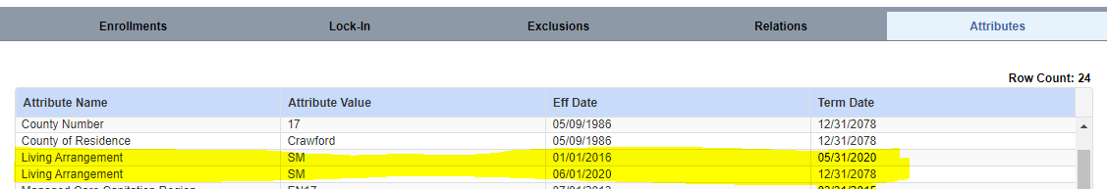
Co-Pays and Co-Pay Exemptions
Living arrangement, hospice, and pregnancy may be indicated as part of the online claim to override co-payments when appropriate with the following overrides:
Pregnancy indicator = 2 (Pregnancy) in NCPDP field #335-2C
Hospice with Patient Residence = 11 in NCPDP field #384-4X
LTCF living arrangement with Patient Residence = 3 (Nursing Facility) or 9 (Intermediate Care Facility) in NCPDP field #384-4X
To find Living Arrangement code in VUE360RX
Member Tab > Attributes

Slide 16
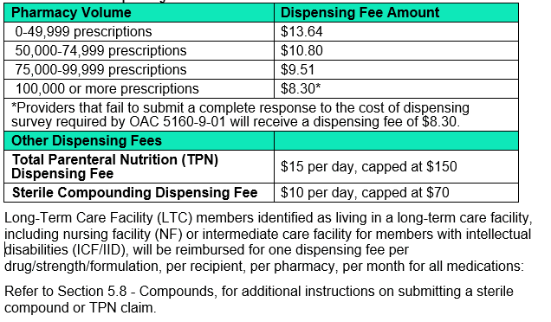
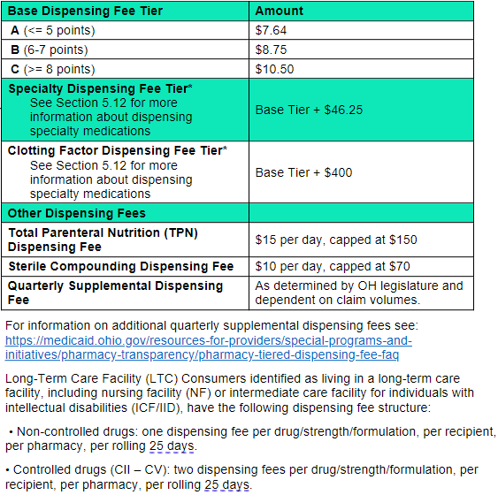
Dispensing Fees

Slide 17
Pharmacy Reimbursement
Claim Payment and Reimbursement- Payment will occur on the same schedules as it currently does for FFS. Thursdays of each week, unless a state holiday falls on M-Th (Friday). Payments will continue to be sent by Gainwell Technologies via EFT or check, depending on provider preference as specified in PNM
 | Fee-for-Service | Managed Care
340B | The ingredient cost will be the lesser of the submitted ingredient costs or fifty percent of wholesale acquisition cost (WAC). If no WAC exists, then pay at lesser of submitted ingredient cost or Ohio Actual Acquisition Cost (OAAC). | Priced using NADAC or WAC in accordance with ORC 5167.123. Please note – this is not a lesser of methodology. Claims price at NADAC and if no NADAC available, then WAC is used
 | Contract Pharmacies are only permitted when an agreement exists between the contract pharmacy and the state medicaid agency. Ohio Medicaid currently has no agreements in place (therefore, contract pharmacy is prohibited in FFS). | Contract pharmacies are permitted
Clotting Factor | The ingredient cost shall be the payment limit shown in the current Medicare Part B drug pricing file, minus the furnishing fee assigned by Medicare Part B. The Medicare Part B pricing file is available at: https://www.cms.gov/medicare/medicare-fee-for-service-part-b-drugs/mcrpartbdrugavgsalesprice. | Priced at the lesser of OAAC or the submitted/usual and customary charge, as determined by the claim’s date of service
 | https://www.cms.gov/medicare/medicare-fee-for-service-part-b-drugs/mcrpartbdrugavgsalesprice
All Others | The ingredient cost shall be the National Average Drug Acquisition Cost (NADAC). If no NADAC has been published by CMS at https://www.medicaid.gov/medicaid/prescription-drugs/pharmacy-pricing/index.html, the ingredient cost shall be the lesser of submitted usual and customary (UAC), submitted ingredient cost, submitted Other Payer Patient Responsibility Amount (OPPRA), WAC,OAAC, or the submitted gross amount due (GAD). | Brand and generic medications, regardless of specialty status, will be priced at the lesser of OAAC, NADAC, WAC, or the submitted/usual and customary charge, as determined by the claim’s date of service.
 | https://www.medicaid.gov/medicaid/prescription-drugs/pharmacy-pricing/index.html

Slide 18
Member Reimbursement
FFS | Managed Care
Member Direct Reimbursement | No member direct reimbursement
No EOBS sent to members | EOBs sent to members

Slide 19
Claims Review
Topic: Claims - Reimbursement Dispute
Fee-for-Service | Managed Care
Same for both - no changes
Topic: Claims - Contact Information
Fee-for-Service | Managed Care
Same for both - no changes
Topic: Claims - Claims Review
Fee-for-Service | Managed Care
Same Concurrent and Desk processes for both - no changes
Interest applies during Desk Claims Review Process | No interest calculations
Gainwell will handle all CHC claims review inquiries beginning 07.01.2023. Gainwell has received all of CHC's Concurrent and Desk Claims Review documentation.

Slide 20
Change HealthCare Reversals
CHC will have a hard shutdown at 11:59:59 on June 30th. 2023
Pharmacies will NOT be able to submit reversals to CHC.
Gainwell will accept the CHC claim reversals back to 07/01/2022 (365 days)

Slide 21
Submission Clarification Codes
 | Fee-for-Service | Managed Care
Medication Synchronization | FFS claims previously used submission clarification codes 47 and 48, now must use 61 | Submission clarification code 61
Emergency Kits, e-kits, e-boxes | FFS claims previously used submission clarification code 16 | Gainwell doesn't accept
LTC re-admit | FFS claims previously used submission clarification code 18 | Gainwell doesn't accept
Submission Clarification Codes are used by the pharmacy to clarify claim processing details and pertain to all classes of trade. These numeric codes are added to claims before submission (or resubmission) in order to, among other things: Provide the third-party payer with further details about the dispensing event.
Medication synchronization is a medication management strategy that aligns the refill dates for two or more prescriptions. When a patient receives multiple prescriptions, it is unlikely the refill dates will all fall on the same day.
Emergency Kits, e-kits and e-boxes are a box or bag that contains the equipment, supplies, and medications needed to provide an initial assessment and to manage life-threatening conditions.

Slide 22
Pharmacy Payment (835’s & RA’s)
Definitions:
RA (Remittance Advice) is a document that contains information about claim payments.
835 is also know as Electronic Remittance Advice (ERA). It is the electronic transaction that provides claim payment information and documents the EFT (electronic funds transfer).
Fee-for-Service | Managed Care
Pharmacies will receive 2 different 835s - one for managed care, one for FFS. FFS financials are separate from SPBM.
835's for managed care and FFS payments will be available through the Gainwell SPBM Portal | 835's for managed care payments will be available through the Gainwell SPBM Portal
Remittance Advices for managed care and FFS will be available in the Gainwell SPBM Portal | Remittance Advices will be available in the Gainwell SPBM Portal

Slide 23
Pharmacy Administered Drugs
An opioid antagonist used for treatment of drug addiction and administered in a long-acting or extended-release form. An opioid antagonist may also be administered for the treatment of alcohol dependence in accordance with approved labeling by the USFDA.
An antipsychotic drug administered in a long-acting or extended-release form.
Medroxyprogesterone caproate for non-pregnant women
Cobalamin
Topic: Vaccines
Fee-for-Service | Managed Care
Some injectable drugs are covered for members with a LTCF living arrangement or may be authorized for those receiving both home health services | There are no changes to MCO

Slide 24
Vaccine Coverages
Fee-for-Service | Managed Care
Seasonal (flu) and Covid-19 are covered through pharmacy benefit with the exception of members younger than 19 years of age, which are covered through the Vaccines for Children program | Seasonal (flu) and Covid-19 are covered through pharmacy benefit
Vaccines, inoculations, and immunizations (other than seasonal/pandemic influenza vaccines or COVID-19 vaccines) are covered as a pharmacy benefit only for residents of nursing facilities/long-term care facilities or intermediate care facilities | All CDC approved vaccines are covered through Managed Care
LTCF - Additional vaccines are covered for this patient population and receive a regular tiered dispensing fee when administered by LTCF staff | LTCF - All CDC approved vaccines are covered through Managed Care. Additional vaccines are covered for this patient population and receive a regular dispensing fee when administered by LTCF staff
Vaccine for Children Program
Vaccines for Children (VFC) | Ohio Department of Health
Immunization | Ohio Department of Health
VFC: Vaccines for Children Program | CDC

Slide 25
Durable Medical Equipment
Fee-for-Service | Managed Care
Limited equipment and supplies as outlined in OAC 5160-9-02 are covered through the pharmacy program when billed by a pharmacy provider. These supplies should be billed using the NDC or UPS on the package through the pharmacy POS claim system.
DME/DMS claims submitted to Gainwell Technologies for services not listed in OAC 5160-9-02 will be denied. Equipment and supplies not listed in OAC 5160-9-02 including enteral nutrition products, should be billed as DME.
DME claims for Medicaid members billed to Medicare Part B or a Medicare Advantage plan as the primary payer must be billed on a medical claim (CMS-1500 claim form or 837P EDI claim transaction). Cost sharing for Medicare Part B services shall not be billed in a pharmacy claim format.

Slide 26
Tamper Resistant Prescription Pads
Tamper Resistant Prescription Pads are only required for Fee For Service claims. Theses requirements do not apply to Managed Care.
Tamper-Resistant Prescription Pad Requirements
Required Characteristic | Examples Include but Not Limited to:
1. One or more features designed to prevent unauthorized copying of a completed or blank prescription form | Text that appears when photocopied or scanned (e.g., “void” or “illegal”)
 | Microprint borders that cannot be copied
2. One or more features designed to prevent the erasure or modification of information written on the prescription by the prescriber | Erasure or use of solvents will discolor background
 | Check-off boxes to indicate the quantity prescribed (e.g.,1-24, 25 -49, 50-74, etc.)
3. One of more features designed to prevent the use of counterfeit prescription forms | Thermochromic ink
 | High security watermark
 | Sequentially numbered
 | Duplicate or triplicate blanks
All written prescriptions billed to Medicaid must be on tamper-resistant forms per OAC 5160-9-06. This includes written prescriptions when ODM is not the primary payer and pays only a portion of the claim. To be considered tamper-resistant a prescription form must contain all three of the following tamper-resistant characteristics.

Slide 27
The tamper-resistant requirement does NOT apply in the following situations:
Payment for prescriptions made by the SPBM for managed care claims
Prescriptions transmitted to the pharmacy via e-prescribing, fax, or telephone
Orders for medications administered in a provider setting and billed by the administering provider
Order for medication administered in a long-term care facility, provided the order is written in the patient’s medical record and given by medical staff directly to the pharmacy. A prescription for a long-term care facility resident is considered tamper-resistant if the patient does not have the opportunity to handle the written order.

Slide 28
Emergency Fill of Non-Tamper Resistant Prescriptions
If a written non-tamper-resistant prescription is presented, the pharmacy may fill the prescription on an emergency basis and obtain a compliant tamper-resistant replacement from the prescriber within 72 hours of dispensing. The pharmacist should use professional judgement to define an emergency situation. A compliant tamper-resistant prescription may be obtained by the following methods:
A compliant written prescription, fax copy, or an electronically transmitted copy. The replacement should be filed with the original, non-tamper-resistant prescription.
The pharmacy may verify the prescription by telephone documenting (on the prescription) the name of the prescriber or prescriber’s office staff member verifying the prescription, date of verification, and identification of the pharmacy staff member requesting verification.

Slide 29
Clinical HelpDesk
Topic: Prior Authorization
Fee-for-Service | Managed Care
Follow same UPDL – Please pay close attention for anything that is specific to FFS Specifically this message in the UPDL **FFS: Physicians who are registered with Ohio Medicaid as having a specialty in psychiatry
CHC’s auto prior authorizations will not transfer to Gainwell. Some callers may believe a PA is already on file. | The PA process for MCE remains the same
If you do not see a legacy PA on file, please advice the caller that a new PA is required!
Fee-for-Service | Managed Care
Same phone numbers for help desk
Same email for help desk

Slide 30
Grievance and Appeals
IMPORTANT – The Grievance and Appeals process is the same for both MCE and FFS.
Contact information is the same for both Fee For Service and Managed Care
Phone/Fax:
No Transfers Available
Fax: 1-833-616-4658
Please ensure that you are giving that number out if someone wants to fax in a grievance or appeal
Email:
OH_MCD_PBM_GA@gainwelltechnologies.com
This is an internal email only and should NEVER be given to members or providers
Information:
Only email G&A for appeal and grievance updates if you do not have access check in Process Manager.

